Slide 1
Ablation Study of QRDQN
311551059 陳昱丞

Slide 2
Outline
Background
Experiments and Result Analysis
Conclusion
Appendix
Reference

Slide 3
Background

Slide 4
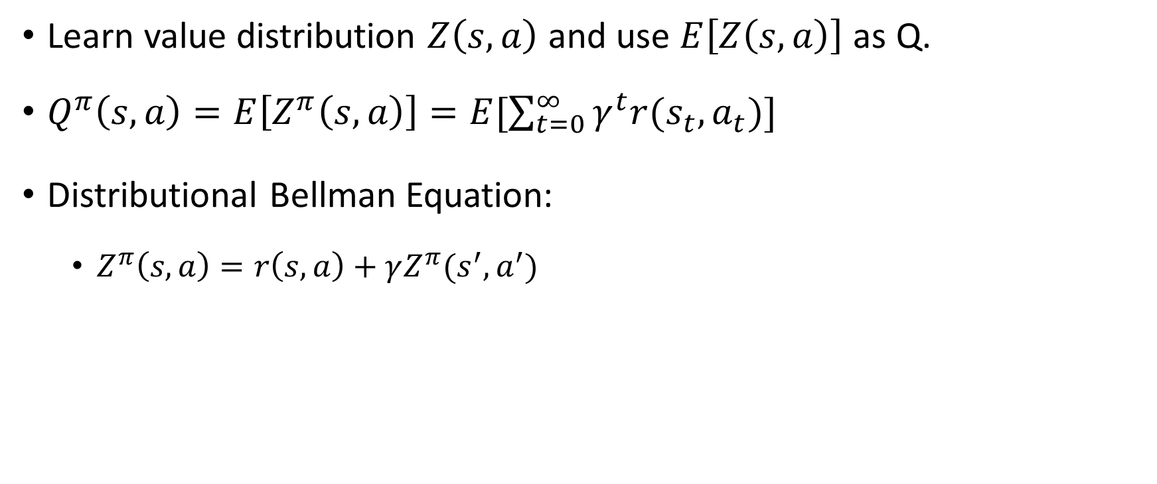
QRDQN
Learn value distribution $Z\left(s,a\right)$ and use $E\left[Z\left(s,a\right)\right]$ as Q.
$Q^{π}\left(s,a\right)=E\left[Z^{π}\left(s,a\right)\right]=E[\sum_{t=0}^{∞}{γ^{t}r(s_{t},a_{t})}]$
Distributional Bellman Equation:
$Z^{π}\left(s,a\right)=r\left(s,a\right)+γZ^{π}(s^{′},a^{′})$

Slide 5
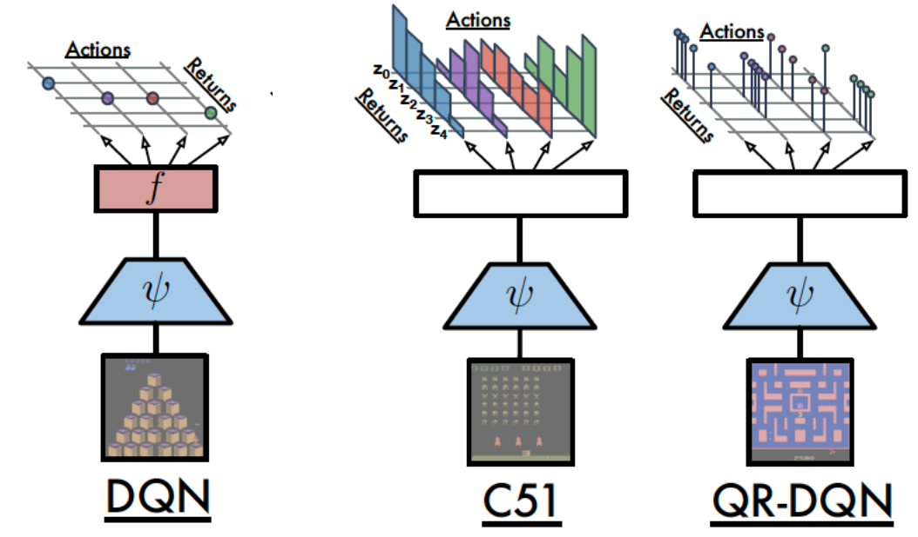
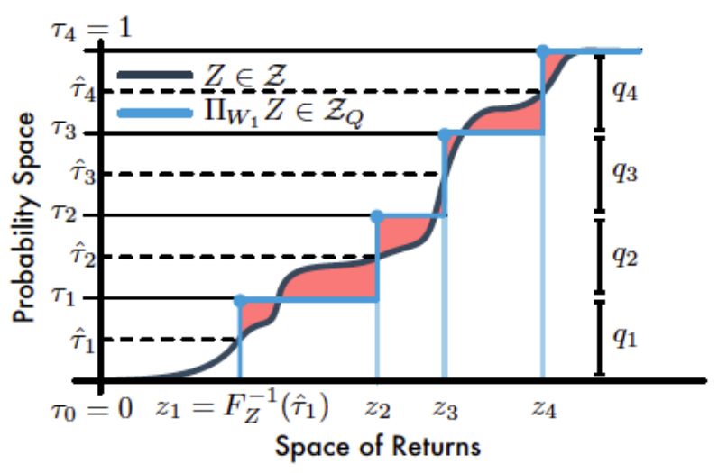

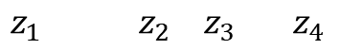

QRDQN
$$\frac{1}{4}$$
$$z_{1} z_{2} z_{3} z_{4}$$
$$1$$
$$\frac{7}{8}$$
$$\frac{3}{4}$$
$$\frac{5}{8}$$
$$\frac{2}{4}$$
$$\frac{1}{4}$$
$$\frac{3}{8}$$
$$\frac{1}{8}$$

Slide 6
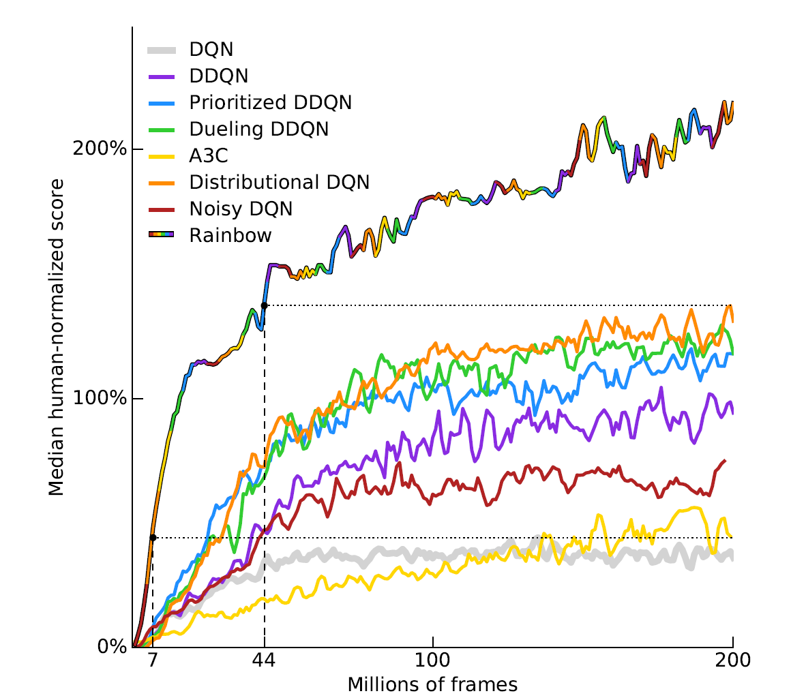
Rainbow
Double Q learning
Prioritized Experience Replay
Dueling networks
Multi-step learning
Noisy Nets
Distributional RL
C51

Slide 7
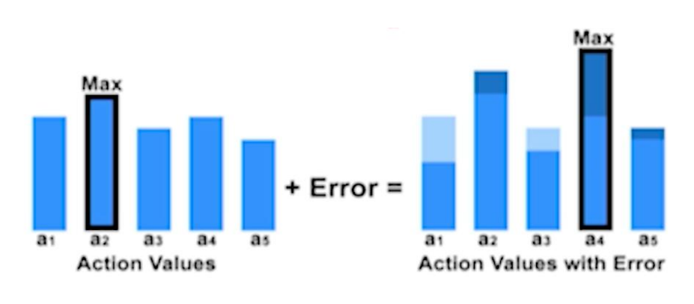
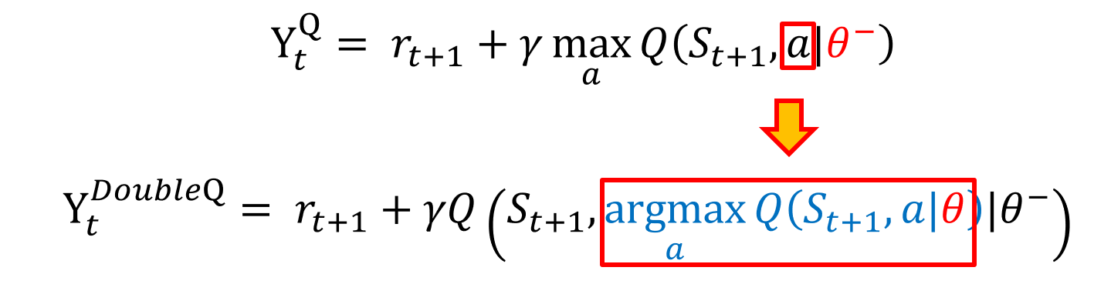
Double Q Learning
DQN suffers from over-estimation.
Behavior and Target network.
Reduce the over-estimation problem.

Slide 8
Prioritized Experience Replay
Sample important transitions from
replay buffer more frequently.
Calculation of importance
is based on TD-error.

Slide 9
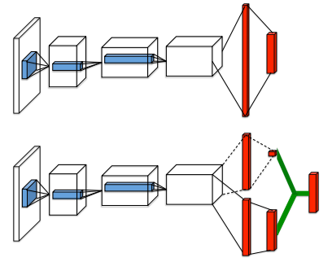
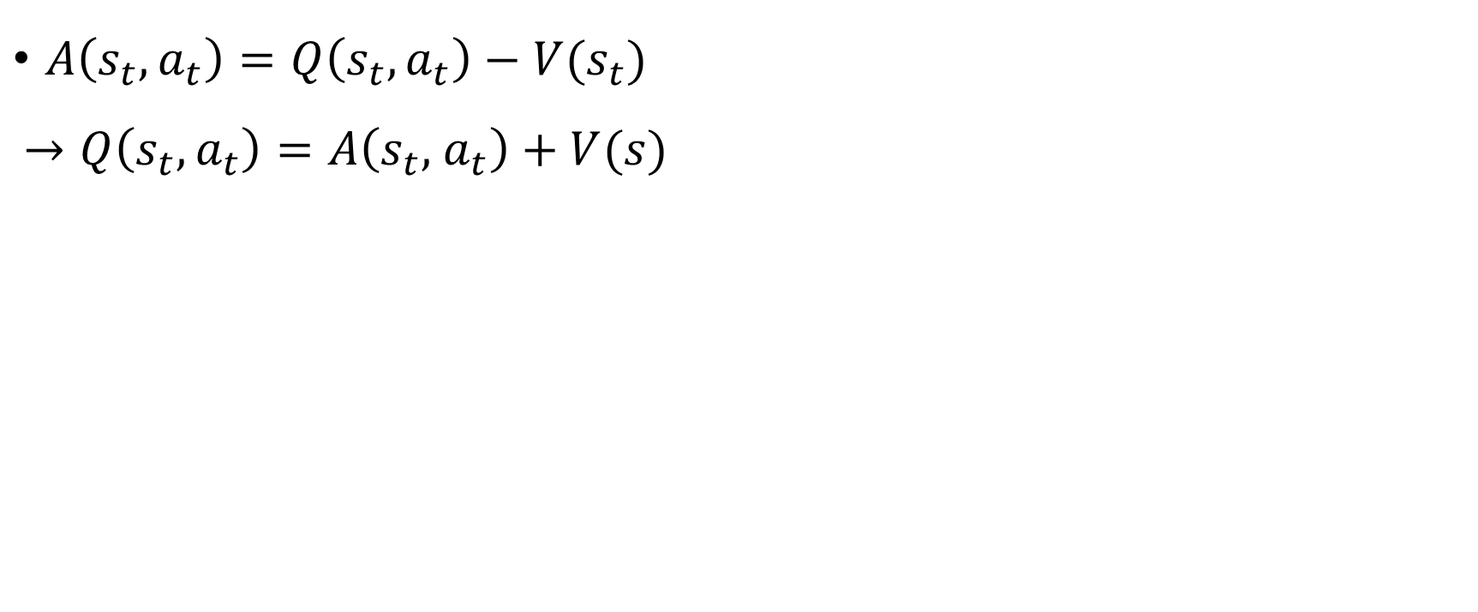



Dueling Networks
$A\left(s_{t}, a_{t}\right)=Q\left(s_{t}, a_{t}\right)−V(s_{t})$
$$→Q\left(s_{t}, a_{t}\right)=A\left(s_{t}, { a}_{t}\right)+V(s)$$
$$V$$
$$Q$$
$$A$$

Slide 10
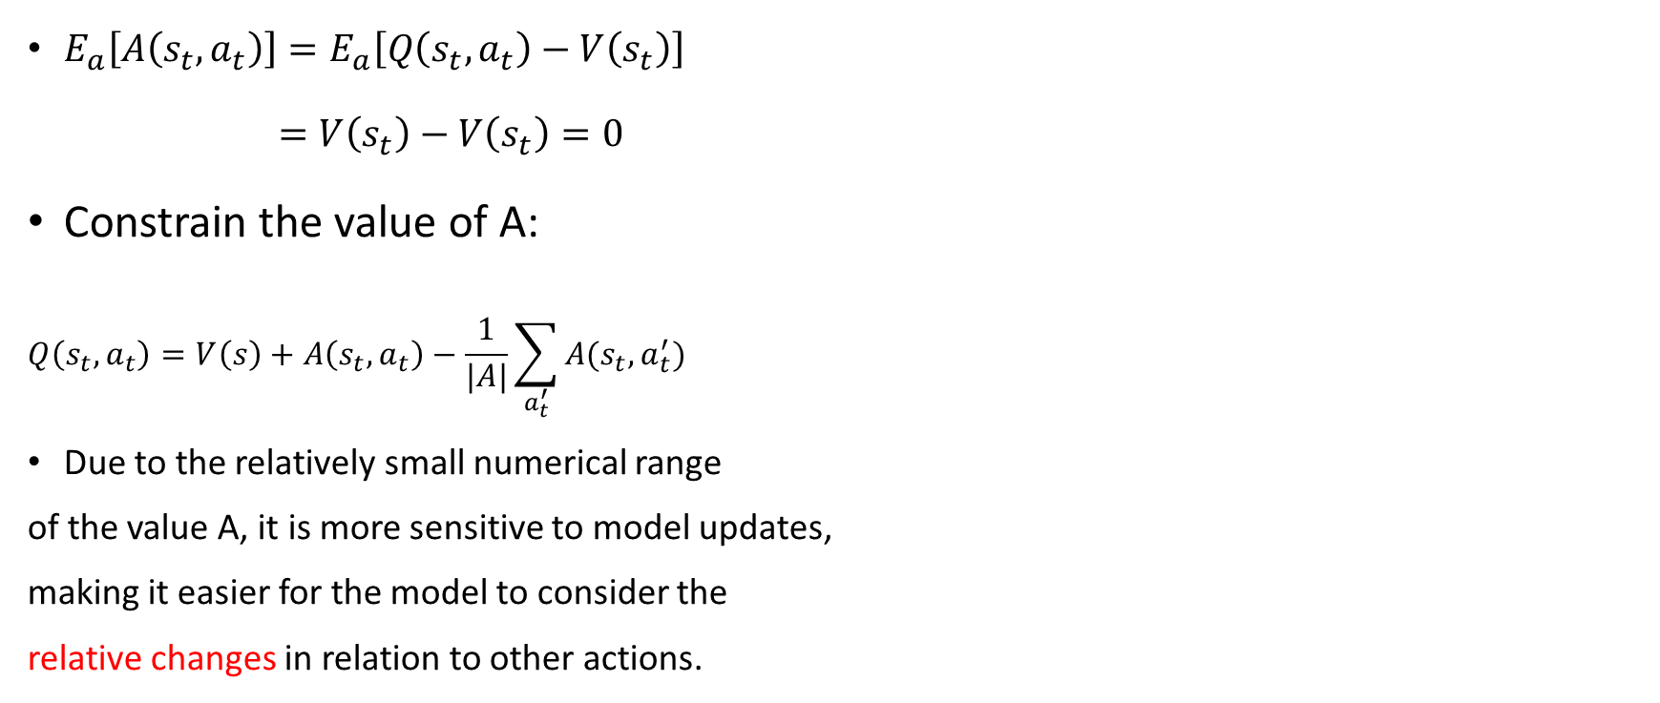
Dueling Networks
$E_{a}\left[A\left(s_{t}, a_{t}\right)\right]=E_{a}\left[Q\left(s_{t}, a_{t}\right)−V\left(s_{t}\right)\right]$
$=V\left(s_{t}\right)−V\left(s_{t}\right)=0$
Constrain the value of A:
$$Q\left(s_{t},a_{t}\right)=V\left(s\right)+A\left(s_{t},a_{t}\right)−\frac{1}{|A|}\sum_{a_{t}^{′}}{A(s_{t},a_{t}^{′})}$$
Due to the relatively small numerical range
of the value A, it is more sensitive to model updates,
making it easier for the model to consider the
relative changes in relation to other actions.

Slide 11
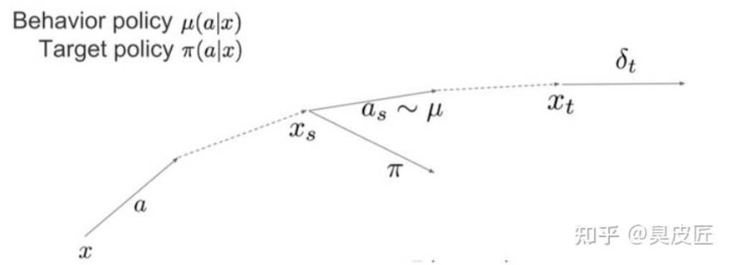
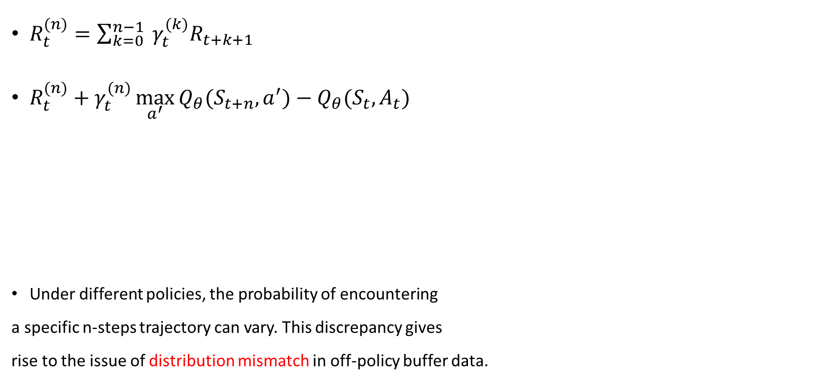
Multi-step Learning
$R_{t}^{(n)}=\sum_{k=0}^{n−1}{ γ_{t}^{(k)}R_{t+k+1}}$
$R_{t}^{(n)}+γ_{t}^{(n)}\max_{a^{′}}{Q_{θ}(S_{t+n},a^{′})}−Q_{θ}(S_{t}, A_{t})$
Under different policies, the probability of encountering
a specific n-steps trajectory can vary. This discrepancy gives
rise to the issue of distribution mismatch in off-policy buffer data.

Slide 12
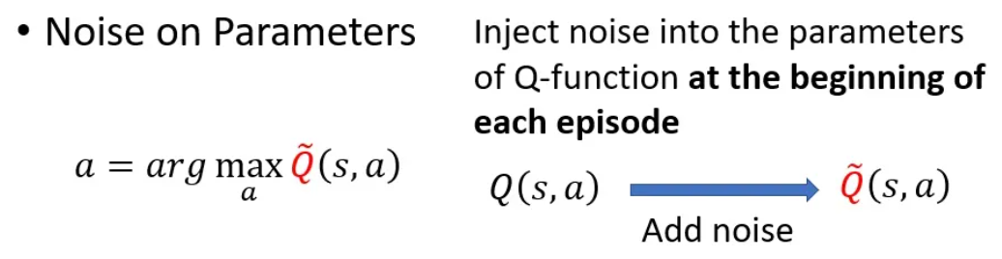
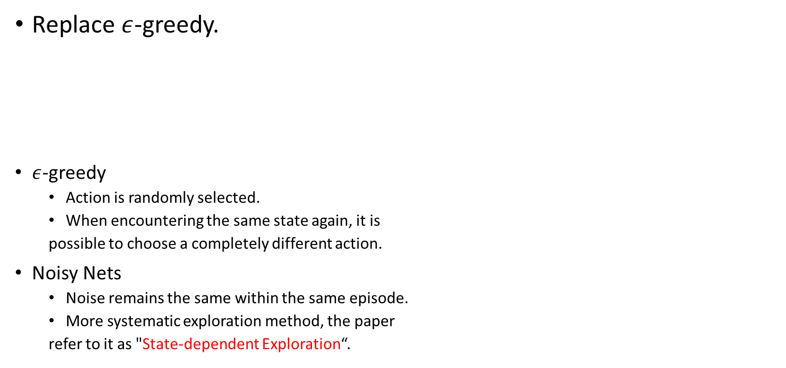
Noisy Nets
Replace $ε$-greedy.
$ε$-greedy
Action is randomly selected.
When encountering the same state again, it is
possible to choose a completely different action.
Noisy Nets
Noise remains the same within the same episode.
More systematic exploration method, the paper
refer to it as "State-dependent Exploration“.

Slide 13
How about Rainbow using QRDQN ?
( QR-Rainbow )

Slide 14
Experiments and Result Analysis

Slide 15
Settings
Environment – Atari games (with NoFrameskip-v4):
Breakout
Enduro (following slides)
MsPacman
Number of frames:
60M to 80M
Comparison:
DQN
QRDQN (N = 200, kappa = 1)
QR origin
QR + Double Q
QR + PER
QR + Dueling
QR + Noisy
QR + Multistep (step=3)
QR Rainbow
num_steps: 50000000
batch_size: 32
lr: 5e-5
memory_size: 1000000
gamma: 0.99
multi_step: 1
update_interval: 4
target_update_interval: 10000
start_steps: 50000
epsilon_train: 0.1
epsilon_eval: 0.01
epsilon_decay_steps: 250000
double_q_learning: False
dueling_net: False
noisy_net: False
use_per: False
log_interval: 100
eval_interval: 250000
num_eval_steps: 125000
max_episode_steps: 27000

Slide 16
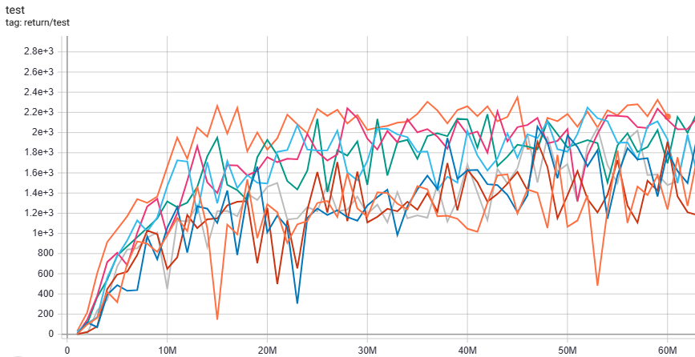
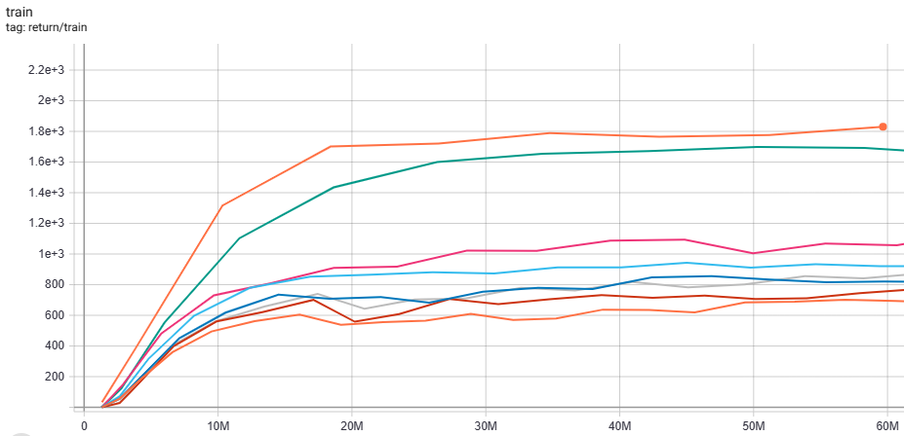
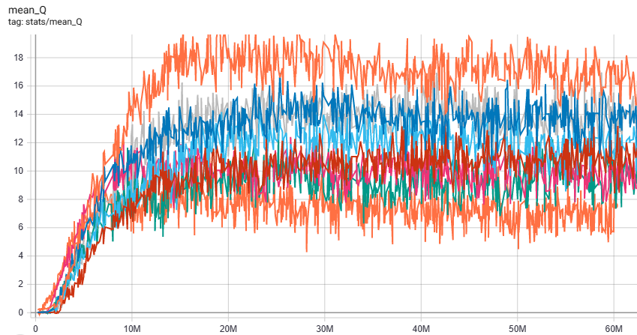
QRDQN Rainbow
DQN
QRDQN
QRDQN Double-Q
QRDQN Dueling Network
QRDQN Multistep Return
QRDQN Noisy Network
QRDQN Prioritize Experience Replay
QRDQN Rainbow

Slide 17
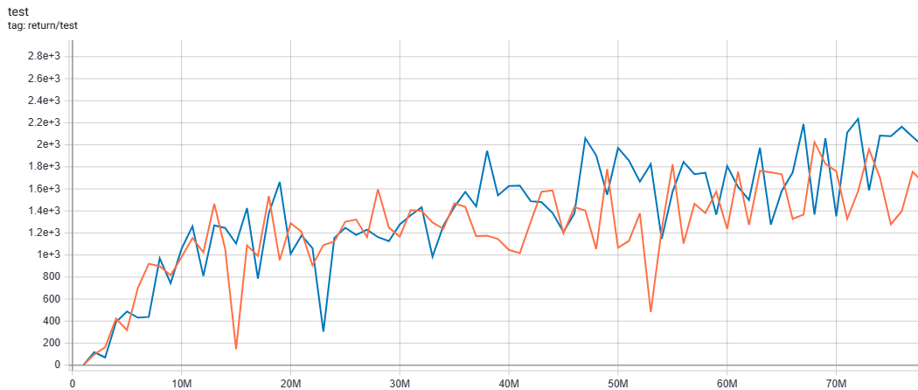
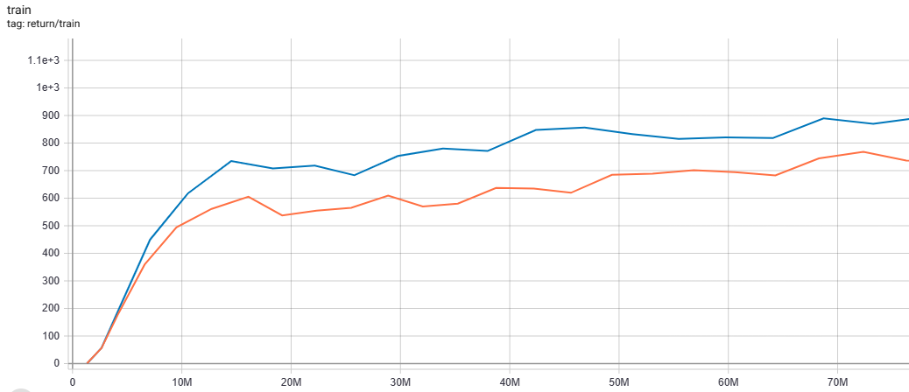
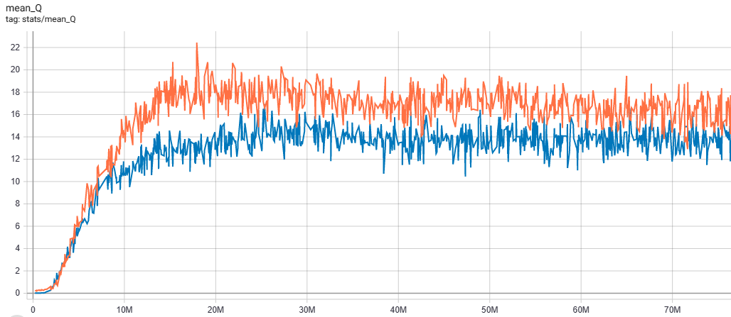

QRDQN vs DQN
Training:
QRDQN > DQN
Testing:
QRDQN > DQN
Estimation of Q:
QRDQN < DQN
DQN
QRDQN

Slide 18
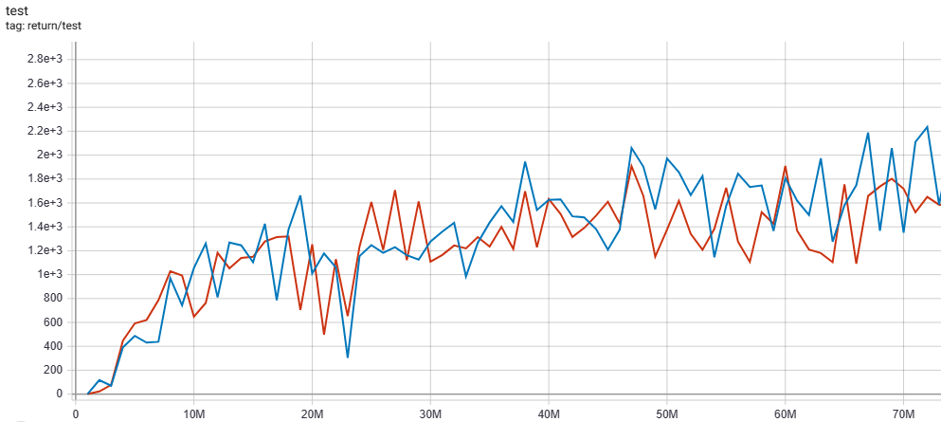
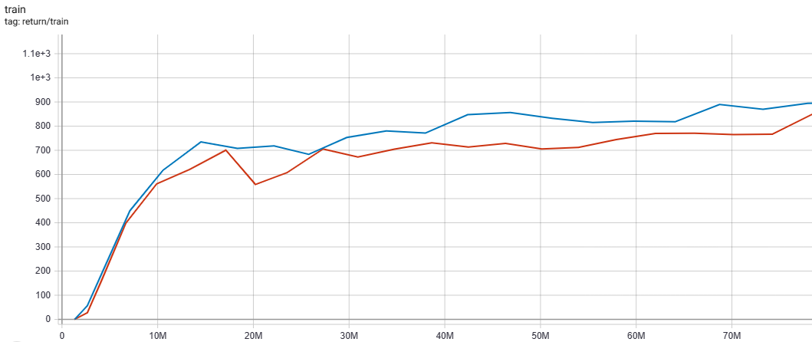
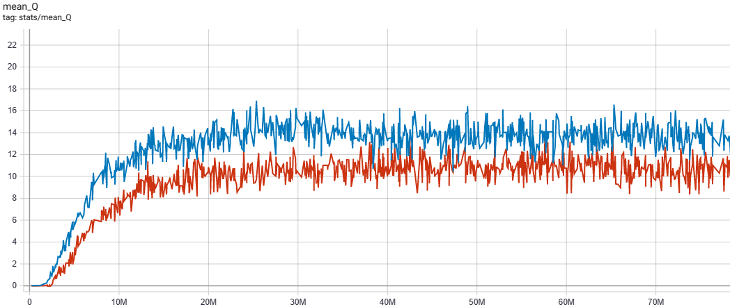

QR vs QR Double-Q
Training:
QRDQN > QR Double-Q
Testing:
QRDQN >= QR Double-Q
Estimation of Q:
QRDQN > QR Double-Q
Reduce over-estimation (?)
QRDQN
QRDQN Double-Q

Slide 19
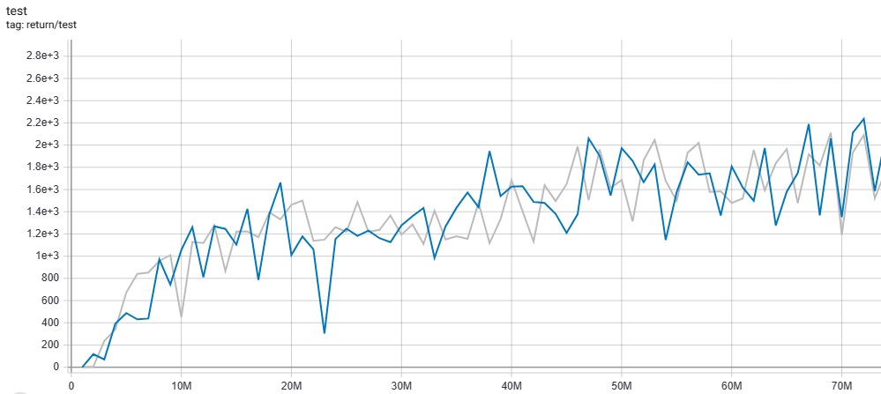
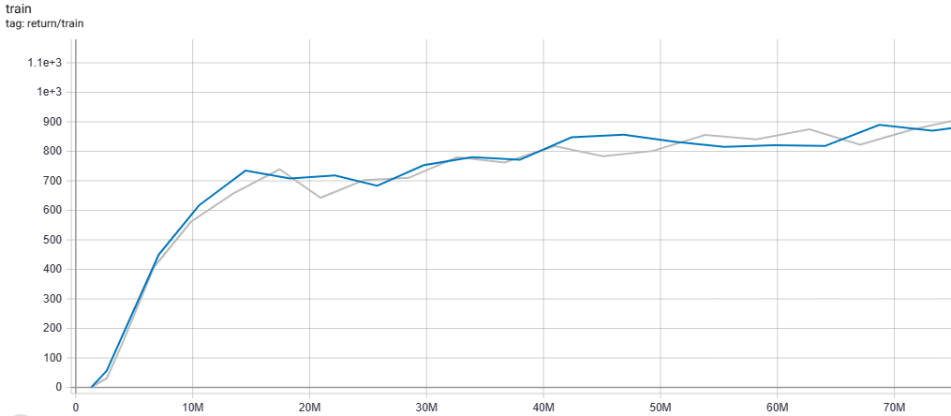
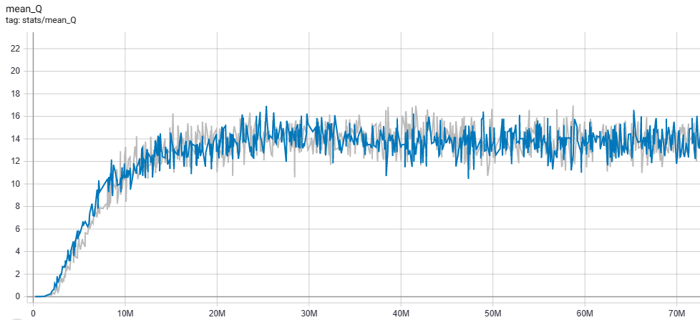
QR vs QR PER
Training:
QRDQN = QR PER
Testing:
QRDQN = QR PER
Estimation of Q:
QRDQN = QR PER
PER is not so effective in dense reward
environment.
QRDQN
QRDQN PER

Slide 20
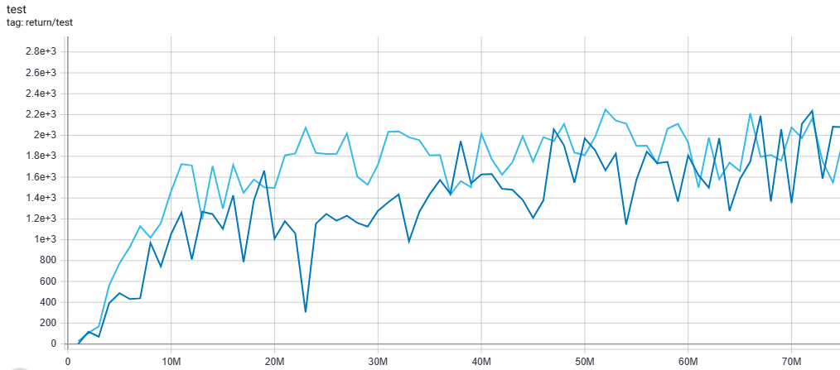
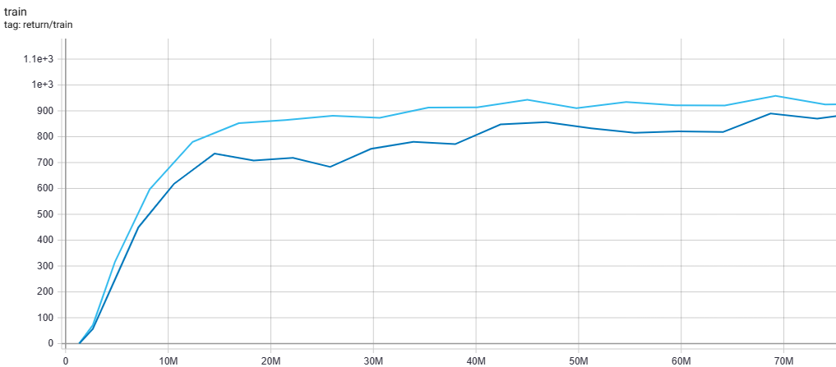
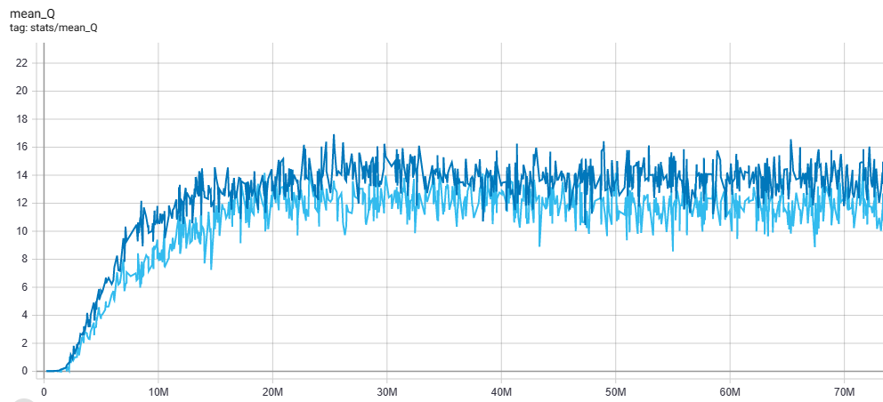

QR vs QR Dueling Network
Training:
QRDQN < QR Dueling
Testing:
QRDQN < QR Dueling
Estimation of Q:
QRDQN > QR Dueling
Great performance against QR in early stage while testing.
QRDQN
QRDQN Dueling

Slide 21
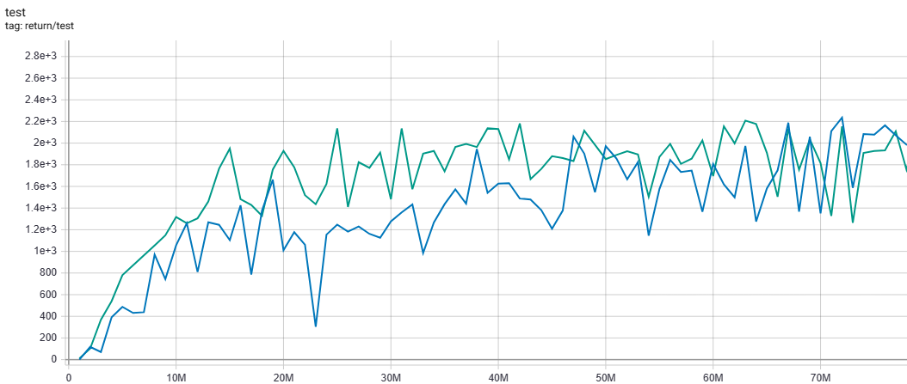
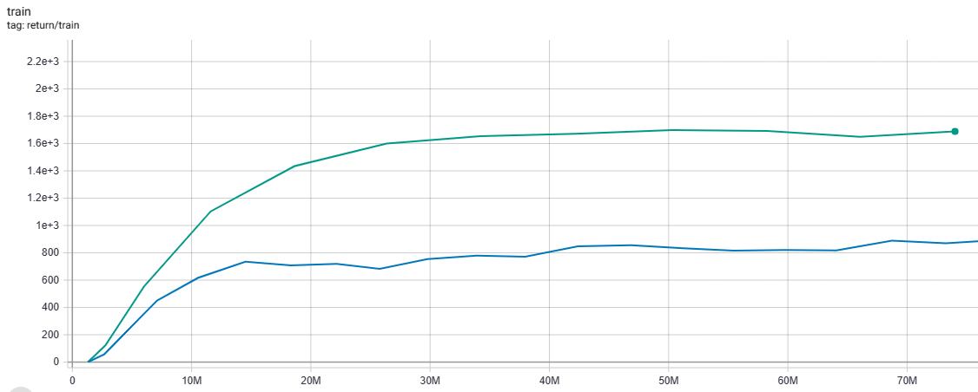
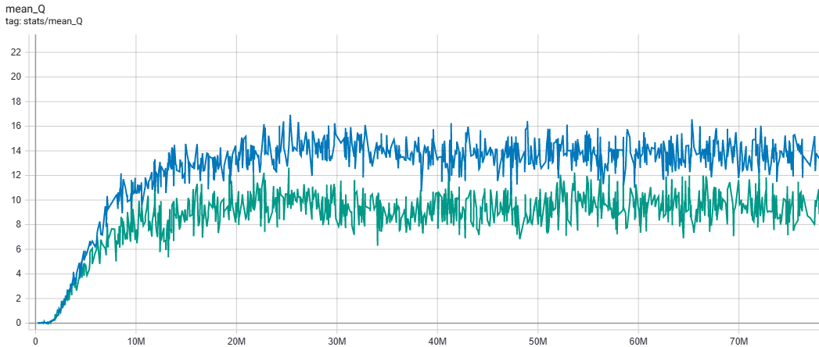
QR vs QR Noisy Network
Training:
QRDQN << QR Noisy
Testing:
QRDQN < QR Noisy
Estimation of Q:
QRDQN > QR Noisy
Excellent performance on training return, but seems not translating into testing.
Sample noise while testing ?
QRDQN
QRDQN Noisy

Slide 22
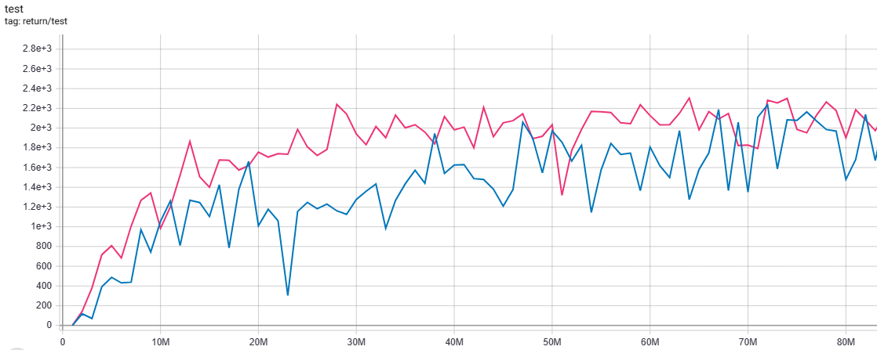

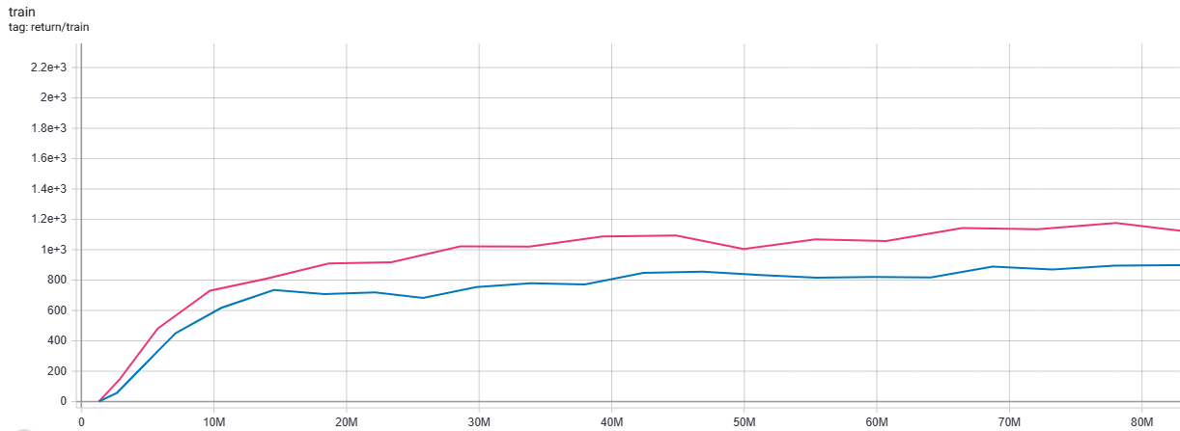
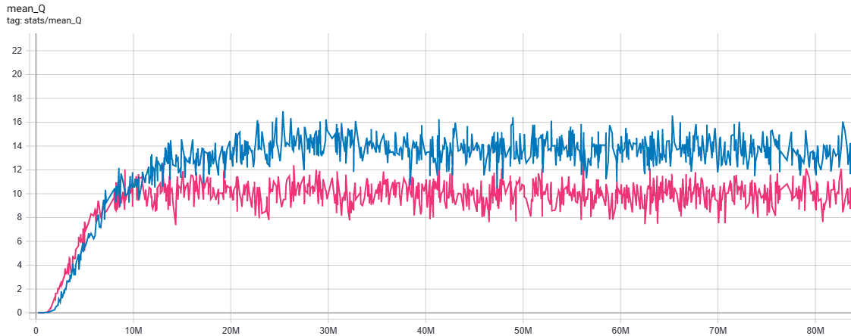
QR vs QR Multistep
QRDQN
Training:
QRDQN < QR Multistep
Testing:
QRDQN < QR Multistep
Estimation of Q:
QRDQN > QR Multistep
High Q-value initially, but as training
progress, Q-value tends to be lower.
QRDQN Multistep

Slide 23
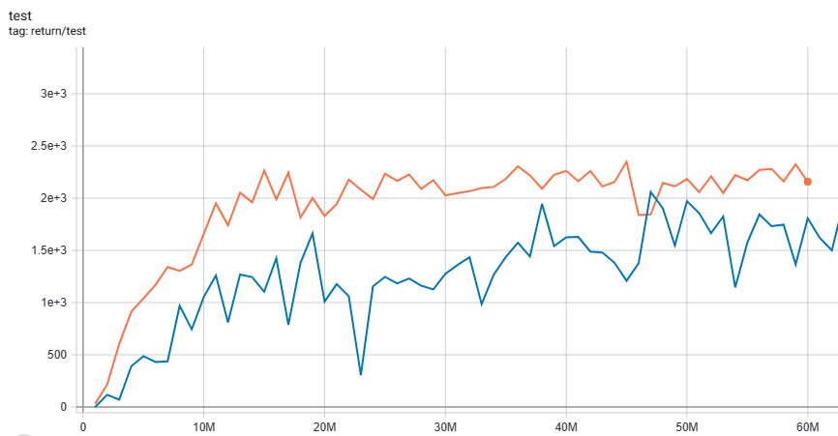
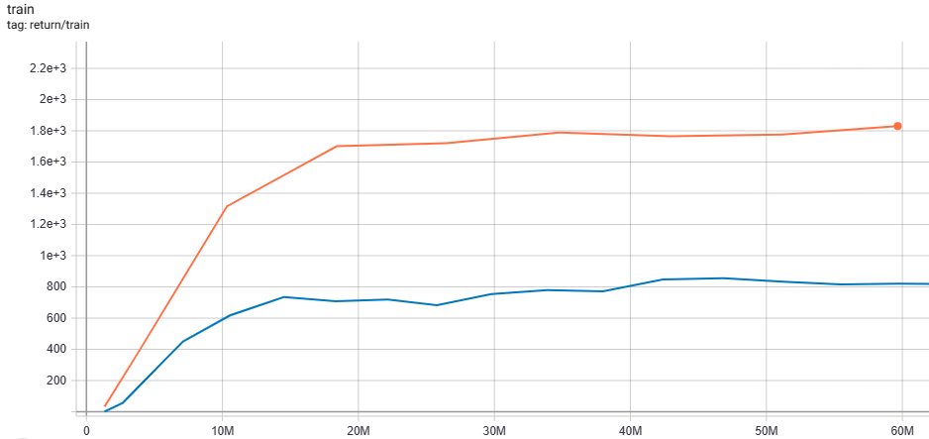
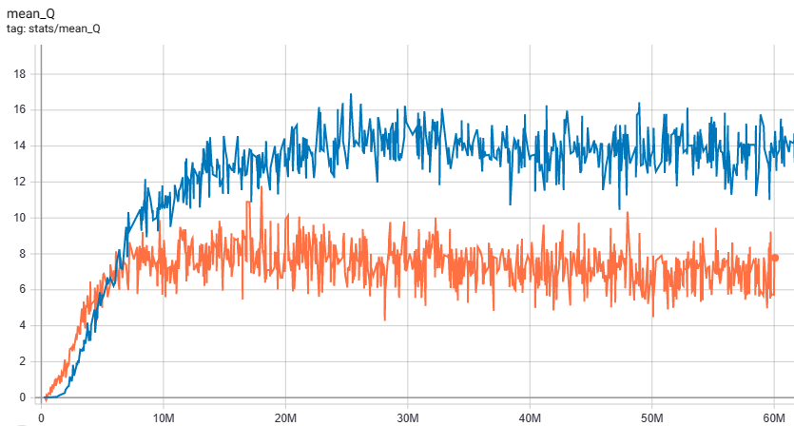
QR vs QR Rainbow
Training:
QRDQN << QR Rainbow
Testing:
QRDQN << QR Rainbow
Estimation of Q:
QRDQN >> QR Rainbow
Best performance.
QRDQN
QRDQN Rainbow

Slide 24
Overall Comparison (in 60M frames)
QR Rainbow: 2349 (45M)
Best testing score:
QR Dueling: 2247 (52M)
QR Multistep: 2240 (28M)
QR Noisy: 2182 (42M)
QRDQN: 2060 (47M)
QR PER: 2046 (53M)
QR Double Q: 1909 (60M)
DQN: 1823 (55M)

Slide 25
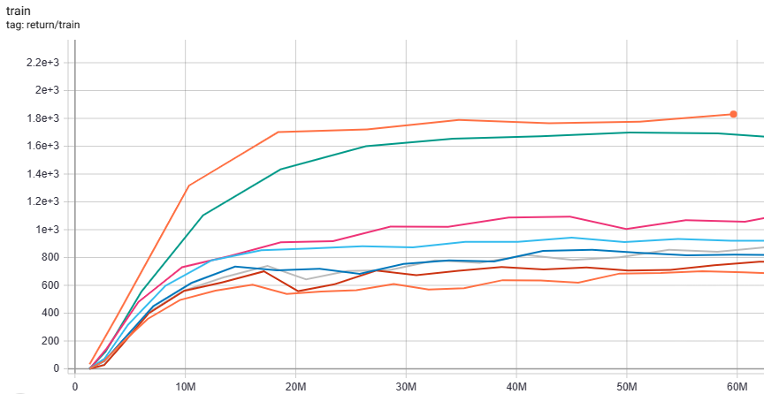
Overall Comparison (in 60M frames)
Training score:
QR Rainbow
QR Noisy
QR Multistep
QR Dueling
QR PER
QRDQN
QR Double Q
DQN

Slide 26
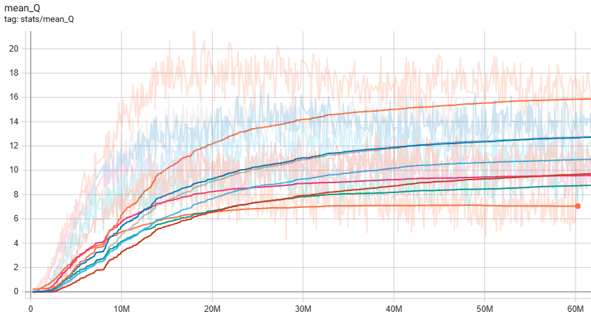
Overall Comparison (in 60M frames)
Estimation of Q-value:
DQN
QRDQN,
QR PER
QR Dueling
QR Multistep,
QR Double Q
QR Noisy
QR Rainbow

Slide 27
Overall Comparison (in 60M frames)
Training speed (0 to 60M) (may not be accurate):
DQN (2d11h)
QR Multistep (2d13h18m)
QR Double-Q (2d13h24m)
QRDQN (2d14h)
QR Dueling (2d16h)
QR Noisy (2d21h)
QR PER (2d22h)
QR Rainbow (3d20h)
Fast
Takes a little bit longer of time
A little bit slow
Very slow

Slide 28
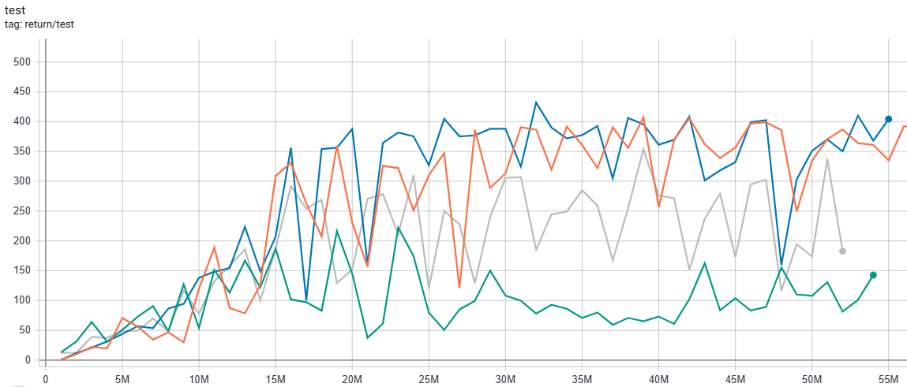
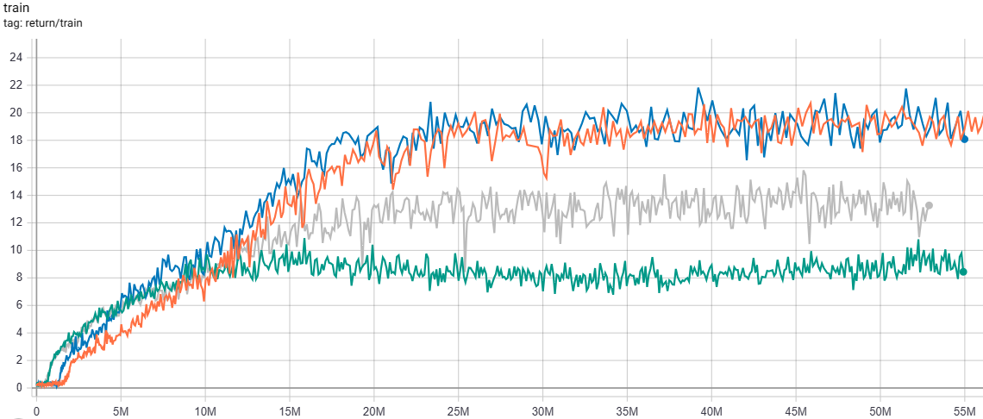
Other Issue – Multistep Return
Some environments may not be suitable for multistep return.
May need some off-policy corrections.
Breakout:
Like Retrace or ACER...
QRDQN
DQN
QRDQN Multistep
QR Rainbow

Slide 29
Other Issue – Noise while Testing
Load the best model of QR Noisy.
Run 1M frames and record the mean return:
Sample noise while testing doesn’t have much impact.
 | With Noise | Without Noise
Enduro | 2143.3 | 2114.6
MsPacman | 3005.95 | 3180.75

Slide 30
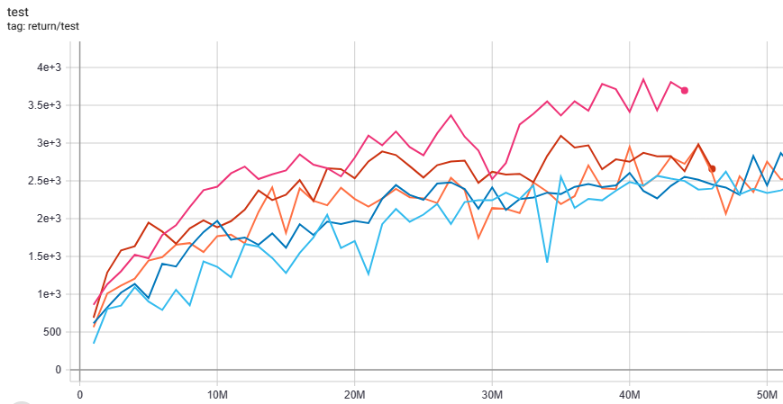
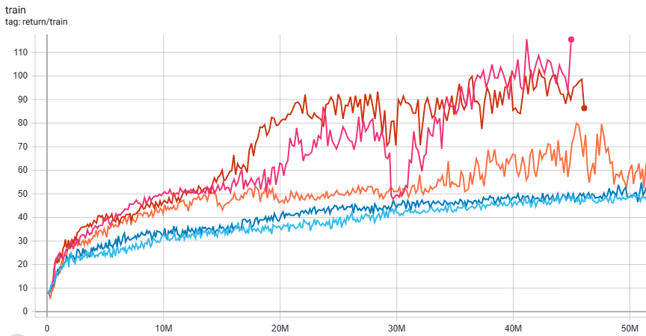
Other Research – IQN, FQF
QR Rainbow
IQN
IQN Rainbow
FQF
FQF Rainbow
MsPacman:

Slide 31
Conclusion

Slide 32
Conclusion
Combining QRDQN with most of the non-distributional methods gets better performance.
QR Rainbow
QR Noisy
QR Multistep
QR Dueling
QR PER
Enduro:
QRDQN
QR Double Q
DQN

Slide 33
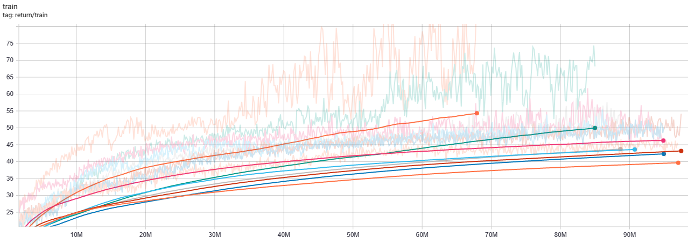
Conclusion
Combining QRDQN with most of the non-distributional methods gets better performance.
QR Rainbow
QR Noisy
QR Multistep
QR Dueling
QR PER
MsPacman:
QR Double Q
QRDQN
DQN

Slide 34
Conclusion
Some environments are not suitable for all methods, so blindly using Rainbow is risky.
It is important to test and confirm the effectiveness of a method in improving performance before incorporating it.
QRDQN
DQN
Breakout:
QR Rainbow
QR Multistep

Slide 35
Further Studies
More games, more environments.
Different kappa (0 or 1) in QRDQN.
Different N in QRDQN.
Compare Rainbow with QR Rainbow.
Add intrinsic motivation (e.g. RND) in QRDQN.
Risk Sensitive QRDQN.

Slide 36
Appendix

Slide 37
Video
QR Rainbow plays Enduro:
https://youtu.be/yWZy-niGd6U
QR Rainbow plays MsPacman:
https://youtube.com/shorts/Tbbh0zdfwRE?feature=share
QRDQN plays Breakout:
https://youtu.be/TA4eBbyK8Mw

Slide 38
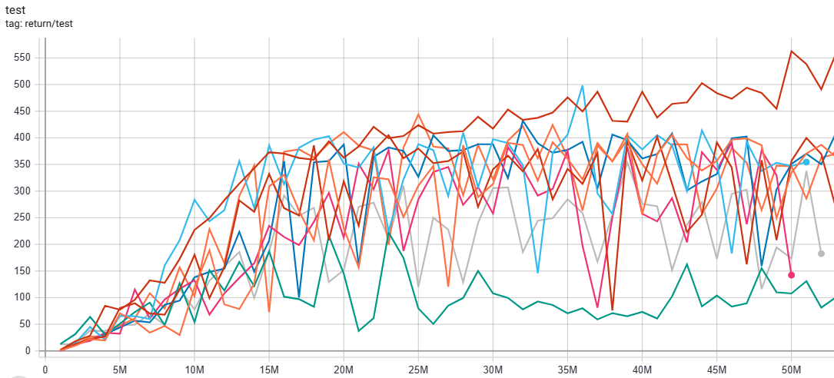

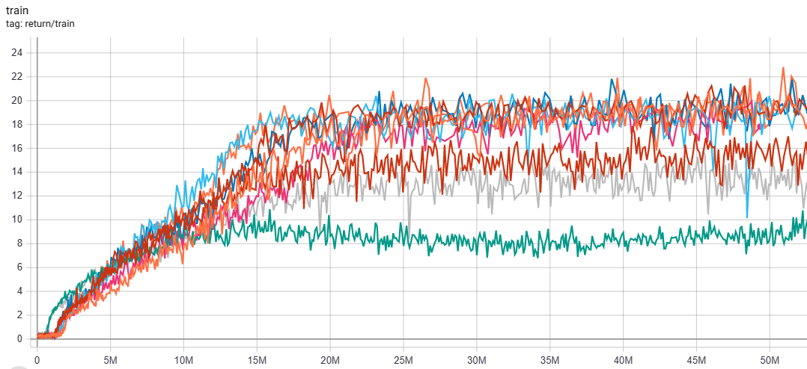
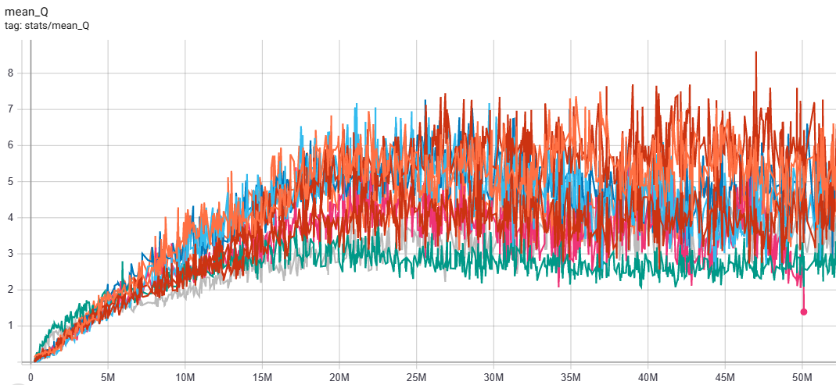
QR Rainbow in Breakout
QRDQN Prioritize Experience Replay
QRDQN
QRDQN Double-Q
QRDQN Dueling Network
QRDQN Noisy Network
QRDQN Multistep Return
QRDQN Rainbow
DQN
QRDQN PER + Double + Dueling

Slide 39
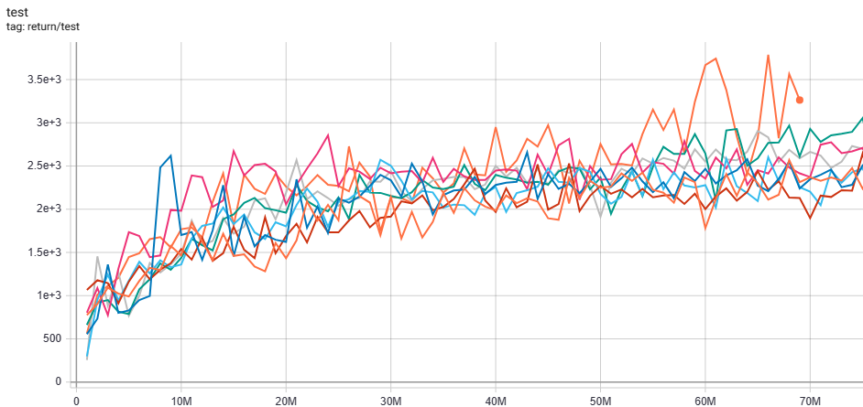
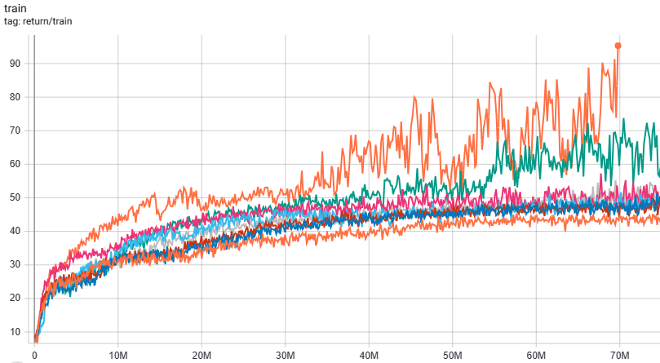

QR Rainbow in MsPacman
DQN
QRDQN
QRDQN Double-Q
QRDQN Dueling Network
QRDQN Multistep Return
QRDQN Noisy Network
QRDQN Prioritize Experience Replay
QRDQN Rainbow

Slide 40


My GitHub Link
https://github.com/yucheng881111/Atari_DQN_Framework

Slide 41
Reference

Slide 42

Reference
Codes modified from:
https://github.com/toshikwa/fqf-iqn-qrdqn.pytorch
Distributional Reinforcement Learning with Quantile Regression | Papers With Code

Slide 43
Reference
Rainbow:
Hessel, Matteo, et al. "Rainbow: Combining improvements in deep reinforcement learning." Proceedings of the AAAI conference on artificial intelligence. Vol. 32. No. 1. 2018.
QRDQN:
Dabney, Will, et al. "Distributional reinforcement learning with quantile regression." Proceedings of the AAAI Conference on Artificial Intelligence. Vol. 32. No. 1. 2018.
Multistep Return:
Hernandez-Garcia, J. Fernando, and Richard S. Sutton. "Understanding multi-step deep reinforcement learning: A systematic study of the DQN target." arXiv preprint arXiv:1901.07510 (2019).
Prioritized Experience Replay:
Schaul, Tom, et al. "Prioritized experience replay." arXiv preprint arXiv:1511.05952 (2015).
Double Q-learning:
Hasselt, Hado. "Double Q-learning." Advances in neural information processing systems 23 (2010).
Van Hasselt, Hado, Arthur Guez, and David Silver. "Deep reinforcement learning with double q-learning." Proceedings of the AAAI conference on artificial intelligence. Vol. 30. No. 1. 2016.

Slide 44
Reference
Dueling Network:
Wang, Ziyu, et al. "Dueling network architectures for deep reinforcement learning." International conference on machine learning. PMLR, 2016.
Noisy Network:
Fortunato, Meire, et al. "Noisy networks for exploration." arXiv preprint arXiv:1706.10295 (2017).
IQN:
Dabney, Will, et al. "Implicit quantile networks for distributional reinforcement learning." International conference on machine learning. PMLR, 2018.
FQF:
Yang, Derek, et al. "Fully parameterized quantile function for distributional reinforcement learning." Advances in neural information processing systems 32 (2019).
Risk Sensitive QRDQN:
Lim, Shiau Hong, and Ilyas Malik. "Distributional Reinforcement Learning for Risk-Sensitive Policies." Advances in Neural Information Processing Systems. 2022.

